Slide 1
IOT BASED AIR POLLUTION MONITORING SYSTEM
Bhavin Panchal: 190170111070

Slide 2
OVERVIEW
This project is for monitoring pollution of our house, factory, office, workshop etc.
This system doesn't only detects the pollution but sends the data to the cloud this makes our project IOT.
We can monitor pollution wherever system is implemented from anywhere on the earth using cloud application.

Slide 3
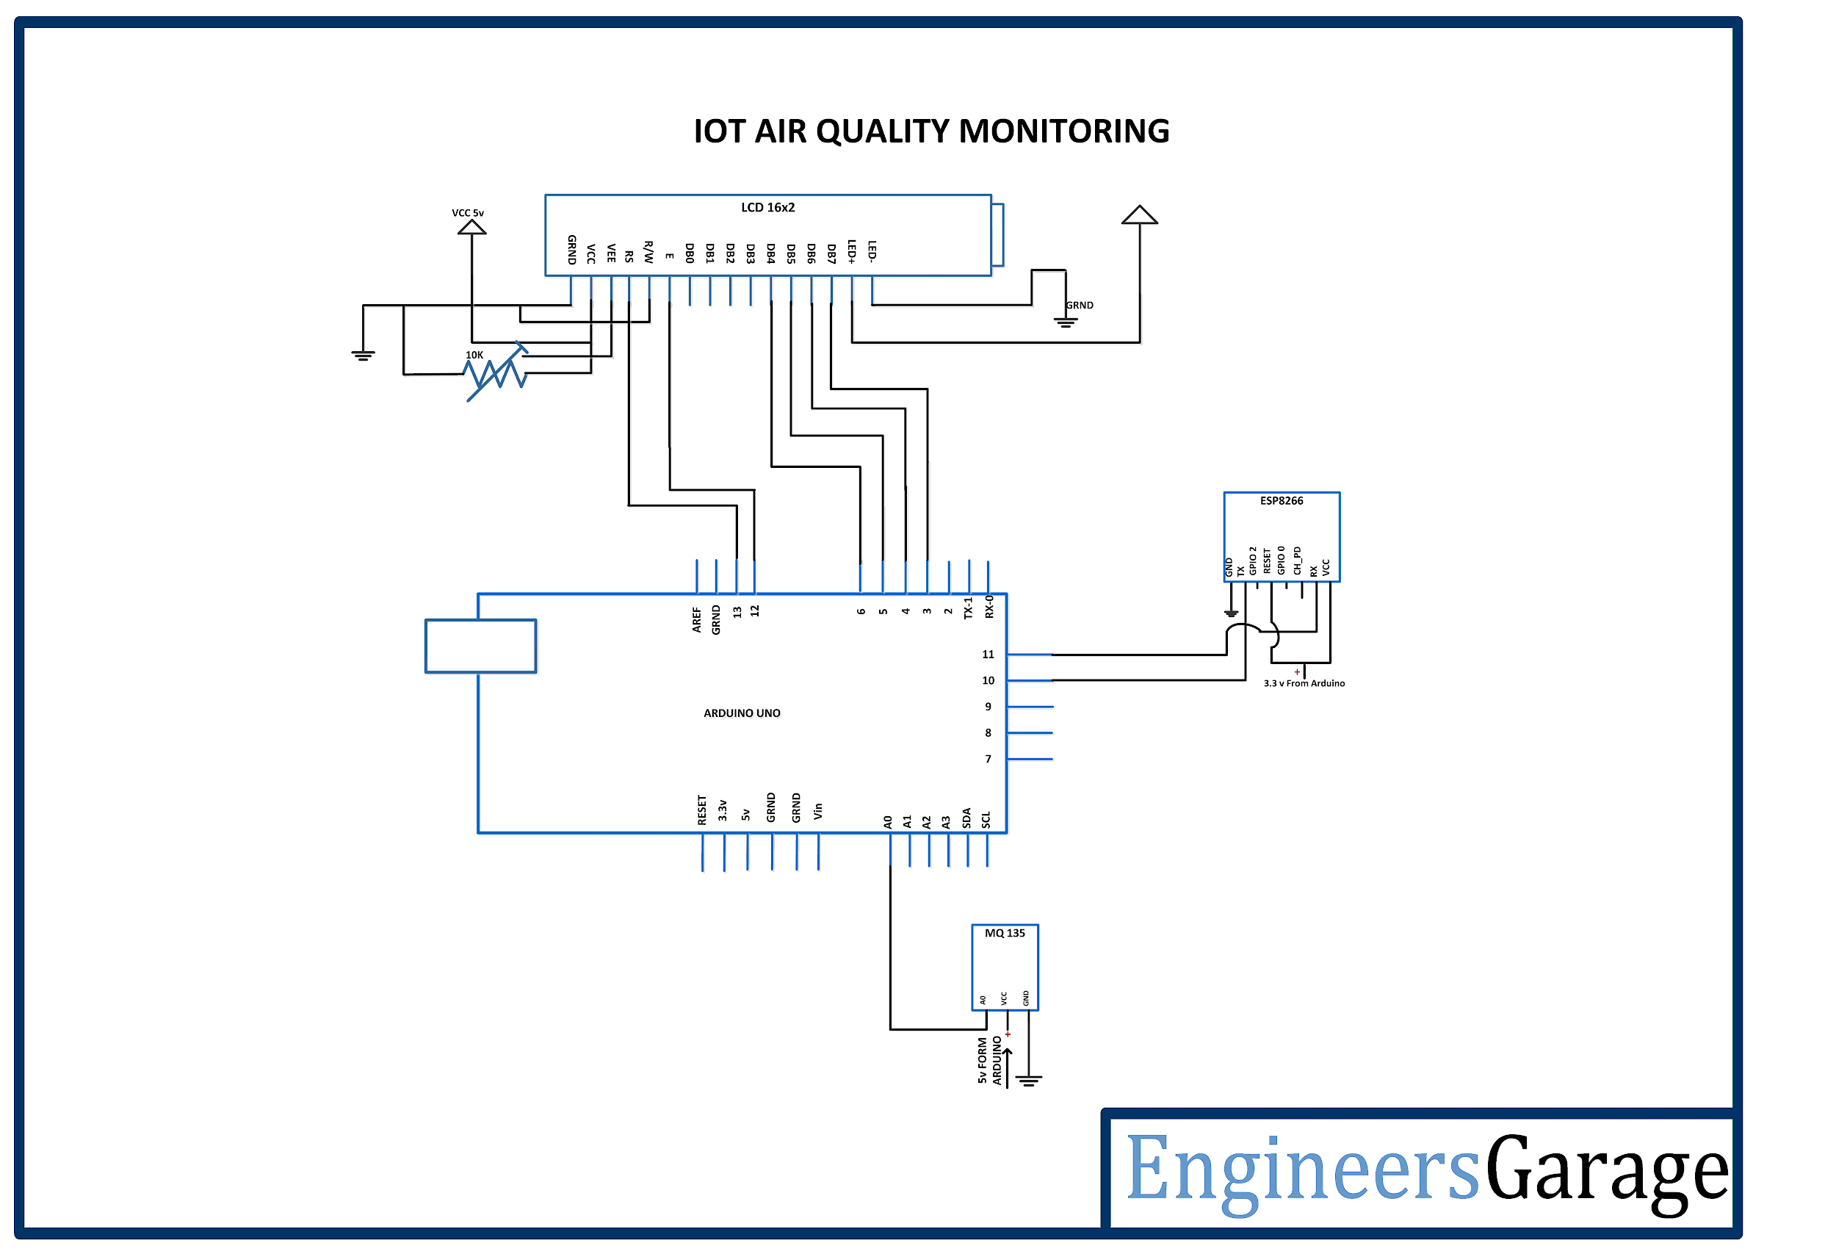

Slide 4
MODULES
Arduino Uno
MQ135 Gas Sensor
16x2 LCD Display
ESP8266 Wifi module

Slide 5
ARDUINO UNO
Arduino UNO is one of the most popular prototyping boards. It is small in size and packed with rich features. The board comes with built-in Arduino boot loader. It is an Atmega 328 based controller board which has 14 GPIO pins, 6 PWM pins, 6 Analog inputs and on board UART, SPI and TWI interfaces. In this IOT device, 9 pins of the board are utilized. There are six pins used to interface the character LCD. There are two pins utilized to interface the ESP8266 Wi-Fi Module and an analog input pin is used to connect with the MQ-135 sensor.

Slide 6
MQ135 GAS SENSOR
MQ-135 is a gas sensor which is used to measure the concentration of combustible gases. It has lower conductivity in clean air while its conductivity increases with the presence of the combustible gases in the air. The sensor is highly sensitive to gases like Ammonia, Sulphide and Benzene steam. The sensor can detect the concentration of combustible gases in range from 100 PPM to 1000 PPM.

Slide 7
16X2 Character LCD DISPLAY
The 16X2 LCD display is used to monitor the sensor values read by the Arduino board from MQ-135. It is interfaced with the Arduino UNO by connecting its data pins D4 to D7 with pins 6 down to 3 of the controller respectively. The RS and E pins of the LCD are connected to pins 13 and 12 of the controller respectively. The RW pin of the LCD module is connected to the ground.

Slide 8
ESP8266 Wi-Fi Module
The ESP8266 Wi-Fi Module is used to connect with any available internet hotspot and transfer sensor data to ThingSpeak Platform via Wi-Fi. The ESP8266 Wi-Fi Module is a self contained SOC with integrated TCP/IP protocol stack that can give any microcontroller access to a Wi-Fi network.

Slide 9
THINGSPEAK SERVER
ThingSpeak is an IoT analytics platform service that allows you to aggregate, visualize, and analyze live data streams in the cloud. You can send data to ThingSpeak from your devices, create instant visualization of live data, and send alerts.
In this project we are using this server to visualise data on the graph using AT commands and API keys

Slide 10
WORKFLOW
When we power on the Arduino it sends the voltage to turn on all the modules connected to it. First MQ135 gas sensor sences the pollution in the air and generate equivalent voltages at the output. Arduino detect output from sensor and convert it to the PPM value according to the algorithms written in the code and Print it on LCD display also sends this data to the Thingspeak through ESP8266 wifi module connected to the internet through hotspot of our mobile or a router. Thingspeak collects the data and visualise data on graph.

Slide 11
FUTURE EXPANSIONS
We can add an ioniser to filter polluted air at some value of PPM.

